Slide 1
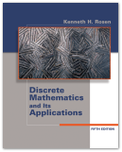
Discrete
Mathematics
Chapter 10
Graphs

Slide 2
Outline
10.1 Graph and Graph Models
10.2 Graph Terminology and Special Types of
Graphs
10.3 Representing Graphs and Graph Isomorphism
10.4 Connectivity
10.5 Euler and Hamiltonian Paths
10.6 Shortest-Path Problems
10.7 Planar Graphs
10.8 Graph Coloring
Ch9-<number>

Slide 3
Outline
10.1 Graph and Graph Models
10.2 Graph Terminology and Special Types of
Graphs
10.3 Representing Graphs and Graph Isomorphism
10.4 Connectivity
10.5 Euler and Hamiltonian Paths
10.6 Shortest-Path Problems
10.7 Planar Graphs
10.8 Graph Coloring
Ch9-<number>

Slide 4
§10.1 Introduction to Graphs
Def 1. A graph G = (V, E) consists of V, a nonempty set of vertices (or nodes), and E, a set of edges. Each edge has either one or two vertices associated with it, called its endpoints. An edge is said to connect its endpoints.
eg.
G=(V, E), where
V={v₁,v₂,…, v₇}
E={{v₁,v₂}, {v₁,v₃}, {v₂,v₃}
{v₃,v₄}, {v₄,v₅}, {v₄,v₆}
{v₄,v₇}, {v₅,v₆}, {v₆,v₇}}
v₁
v₅
v₃
v₄
v₆
v₂
v₇
Ch9-<number>

Slide 5
Def A graph in which each edge connects two different vertices and where no two edges connect the same pair of vertices is called a simple graph.
Def Multigraph:
simple graph + multiple edges (multiedges)
(兩點間允許多條邊)
eg.
V₁
V₅
V₃
V₄
V₆
V₂
V₇
Ch9-<number>

Slide 6
Def. Pseudograph:
simple graph + multiedge
+ loop
(a loop: )
eg.
Ch9-<number>

Slide 7
Def 2. Directed graph (digraph):
simple graph with each edge directed
Note: is allowed in a directed graph
Note:
u
v
u
v
The two edges (u,v),(u,v)
are multiedges.
The two edges (u,v),
(v,u) are not multiedges.
Def. Directed multigraph: digraph+multiedges
Ch9-<number>

Slide 8
Table 1. Graph Terminology
Type | Edges | Multiple Edges | Loops
(simple) graph | undirectededge: {u,v} |  | 
Multigraph |  |  | 
Pseudograph |  |  | 
Directed graph | directed edge: (u,v) |  | 
Directed multigraph |  |  | 
Exercise : 3, 5, 6, 7, 9
Ch9-<number>

Slide 9
Graph Models
Example 2. (Acquaintanceship graphs)
We can use a simple graph to represent whether two people know each other. Each person is represented by a vertex. An undirected edge is used to connect two people when these people know each other.
eg
Jan
Paula
Todd
Kamlesh
Amy
Lila
Lizd
Steve
Ch9-<number>

Slide 10
Example 3. (Influence graphs)
In studies of group behavior it is observed that certain people can influence the thinking of others.
Simple digraph ⇒ Each person of the group is represented by a vertex. There is a directed edge from vertex a to vertex b when the person a influences the person b.
eg
Linda
Brian
Deborah
Fred
Yvonne
Ch9-<number>

Slide 11
Example 9. (Precedence graphs and concurrent processing)
Computer programs can be executed more rapidly by executing certain statements concurrently. It is important not to execute a statement that requires results of statements not yet executed.
Simple digraph ⇒ Each statement is represented by a vertex,
and there is an edge from a to b
if the statement of b cannot be
executed before the statement of a.
S₆
S₅
eg
S₁: a:=0
S₂: b:=1
S₃: c:=a+1
S₄: d:=b+a
S₅: e:=d+1
S₆: e:=c+d
S₃
S₄
S₁
S₂
Ch9-<number>

Slide 12
Ex 13. The intersection graph of a collection of sets A₁, A₂, …, A_{n} is the graph that has a vertex for each of these sets and has an edge connecting the vertices representing two sets if these sets have a nonempty intersection. Construct the intersection graph of the following collection of sets.
(a) A₁ = {0, 2, 4, 6, 8}, A₂ = {0, 1, 2, 3, 4},
A₃ = {1, 3, 5, 7, 9}, A₄ = {5, 6, 7, 8, 9}, A₅ = {0, 1, 8, 9}.
(請做此作業)
Ch9-<number>

Slide 13
§10.2 Graph Terminology
Def 1. Two vertices u and v in a undirected graph G are called adjacent (or neighbors) in G if {u, v} is an edge of G.
Def 2. The degree of a vertex v, denoted by deg(v),
in an undirected graph is the number of edges
incident with it.
Note : adjacent: a vertex connected to a vertex
incident: a vertex connected to an edge
(Note : A loop adds 2 to the degree.)
Ch9-<number>

Slide 14
Example 1. What are the degrees of the vertices in the graph H ?
Sol :
a
b
deg(a)=4
c
deg(b)=6
deg(c)=1
deg(d)=5
e
d
f
deg(e)=6
H
deg(f)=0
Def. A vertex of degree 0 is called isolated.
Ch9-<number>

Slide 15
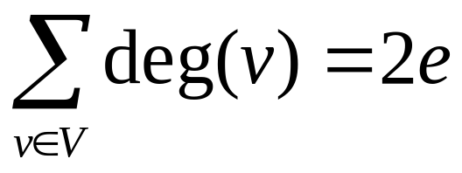
Thm 1. (The Handshaking Theorem)
Let G = (V, E) be an undirected graph with
e edges (i.e., |E| = e). Then
Pf : 每加一條 edge {u, v} 會同時使 u 跟 v
各增加一個degree
Ch9-<number>

Slide 16
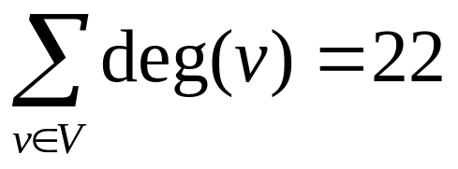
eg. The graph H has 11
edges, and
a
b
c
e
d
f
H
Example 3. How many edges are there in a
graph with 10 vertices each of
degree six?
Sol :
10 ⋅ 6 = 2e ⇒ e=30
Ch9-<number>

Slide 17
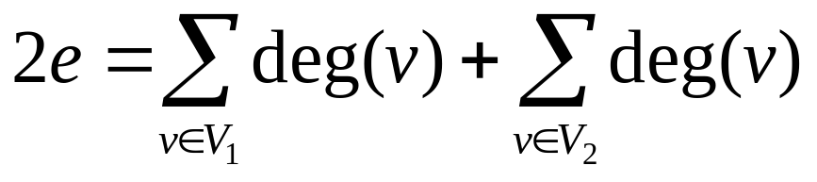
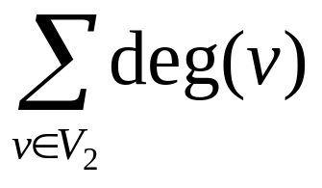
Thm 2. An undirected graph G = (V, E) has an even number of vertices of odd degree.
Pf : Let V₁={v∈V | deg(v) is even},
V₂={v∈V | deg(v) is odd}.
⇒
is even.
Exercise : 5
Def 3. G = (V, E): directed graph,
e = (u, v) ∈ E : u is adjacent to v
v is adjacent from u
u : initial vertex of e
v : terminal (end) vertex of e
u
e
v
Ch9-<number>

Slide 18
Def 4.
G = (V, E) : directed graph, v∈V
deg⁻(v) : # of edges with v as a terminal.
(in-degree)
deg⁺(v) : # of edges with v as a initial vertex
(out-degree)
Example 4.
deg⁻(a)=2, deg⁺(a)=4
deg⁻(b)=2, deg⁺(b)=1
deg⁻(c)=3, deg⁺(c)=2
deg⁻(d)=2, deg⁺(d)=2
deg⁻(e)=3, deg⁺(e)=3
deg⁻(f )=0, deg⁺(f )=0
b
a
c
e
d
f
Ch9-<number>

Slide 19
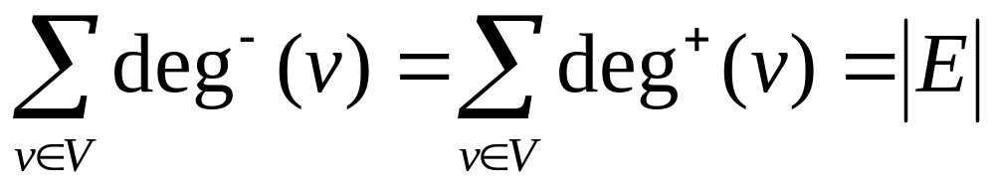
Thm 3. Let G = (V, E) be a digraph. Then
pf :
每增加一條 edge deg⁺(u)增加 1 deg⁻(v)增加 1
u
v
Ch9-<number>

Slide 20
(ex47上面) A simple graph G=(V, E) is called
regular if every vertex of this graph has the
same degree. A regular graph is called
n-regular if deg(v)=n , ∀v∈V.
eg.
K₄ :
is 3-regular.
Exercise : 7, 49
Ch9-<number>

Slide 21
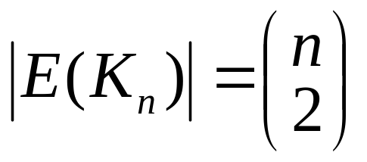
Some Special Simple Graphs
Example 5.
The complete graph on n vertices, denoted
by K_{n}, is the simple graph that contains
exactly one edge between each pair of
distinct vertices.
K₁
K₂
K₃
K₄
Note. K_{n} is (n−1)-regular, |V(K_{n})|=n,
Ch9-<number>

Slide 22
Example 6. The cycle C_{n}, n≥3, consists of n vertices v₁, v₂, …, v_{n} and edges {v₁,v₂}, {v₂,v₃}, …, {v_{n−1},v_{n}}, {v_{n},v₁}.
C₃
C₄
C₅
Note C_{n} is 2-regular, |V(C_{n})| = n, |E(C_{n})| = n
Ch9-<number>

Slide 23
Example 7. We obtained the wheel W_{n} when we add an additional vertex to the cycle C_{n}, for n≥3, and connect this new vertex to each of the n vertices in C_{n}, by new edges.
W₆
W₅
Note. |V(W_{n})| = n + 1, |E(W_{n})| = 2n,
W_{n} is not a regular graph if n ≠ 3.
Ch9-<number>

Slide 24
Example 8. The n-dimensional hypercube, or
n-cube, denoted by Q_{n}, is the graph that has vertices representing the 2^{n} bit strings of length n.
Two vertices are adjacent if and only if the bit strings that they represent differ in exactly one bit position.
110
111
10
11
0
1
100
101
Q₁
010
另法：Q_{n−1}點數
即每個dim邊數，
共n-dim
00
01
011
Q₂
000
001
Q₃
Note. Q_{n} is n-regular, |V(Q_{n})| = 2^{n}, |E(Q_{n})| = (2^{n}n)/2 =2^{n−1}n
Ch9-<number>
deg總和 / 2

Slide 25
Some Special Simple Graphs
Def 5. A simple graph G=(V,E) is called bipartite if V can be partitioned into V₁ and V₂, V₁∩V₂=∅, such that every edge in the graph connect a vertex in V₁ and a vertex in V₂.
Example 9.
v₁
v₂
v₃
v₄
∴ C₆ is bipartite.
v₅
v₆
V₁
V₂
Ch9-<number>

Slide 26
Example 10. Is the graph G bipartite ?
a
b
a
c
g
c
e
b
f
f
d
d
g
e
G
Yes !
Ch9-<number>

Slide 27
Thm 4. A simple graph is bipartite if and only if it is possible to assign one of two different colors to each vertex of the graph so that no two adjacent vertices are assigned the same color.
Example 12. Use Thm 4 to show that G is bipartite.
1
a
1
b
2
2
g
c
2
1
f
d
2
e
G
Exercise : 23, 24, 25
Ch9-<number>

Slide 28
Example 11. Complete Bipartite graphs (K_{m,n})
K_{2,3}
K_{3,3}
Note. |V(K_{m,n})| = m+n, |E(K_{m,n})| = mn,
K_{m,n} is regular if and only if m=n.
Ch9-<number>

Slide 29
New Graphs from Old
Def 6. A subgraph of a graph G=(V, E) is a
graph H=(W, F) where W ⊆ V and F ⊆ E.
(注意 F 要連接 W 裡的點)
Example 14. A subgraph of K₅
a
a
e
b
b
e
d
c
c
K₅
subgraph of K₅
Ch9-<number>

Slide 30
Def 7. The union of two simple graphs
G₁=(V₁, E₁) and G₂=(V₂, E₂) is the simple graph
G₁∪G₂=(V₁∪V₂, E₁∪E₂)
Example 15.
a
b
c
a
b
c
G₁
G₂
d
e
d
f
a
b
c
G₁∪G₂
Exercise : 51
Ch9-<number>
d
e
f

Slide 31
(ex35上面) A simple graph G=(V, E) is called
regular if every vertex of this graph has the
same degree. A regular graph is called
n-regular if deg(v)=n , ∀v∈V.
eg.
K₄ :
is 3-regular.
Exercise : 5, 7, 21, 23, 25, 35, 37
Ch9-<number>

Slide 32
§10.3 Representing Graphs and
Graph Isomorphism
※Adjacency list
Example 1. Use adjacency lists to describe the simple graph given below.
Sol :
Vertex | Adjacent Vertices
a | b,c,e
b | a
c | a,d,e
d | c,e
e | a,c,d
b
a
c
e
d
Ch9-<number>

Slide 33
Example 2. (digraph)
b
Initial vertex | Terminal vertices
a | b,c,d,e
b | b,d
c | a,c,e
d
e | b,c,d
c
a
e
d
Exercise : 3
Ch9-<number>

Slide 34
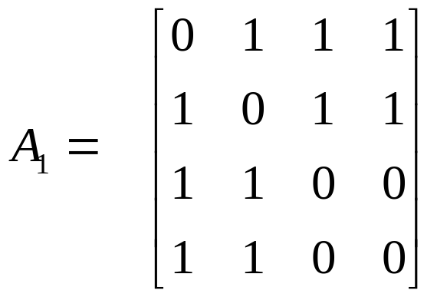
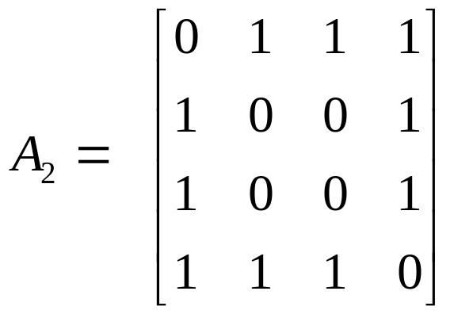
※Adjacency Matrices
Def. G=(V, E) : simple graph, V={v₁,v₂,…,v_{n}}. (順序沒關係)
A matrix A is called the adjacency matrix of G
if A=[a_{ij}]_{n×n} , where a_{ij} = 1, if {v_{i},v_{j}}∈E,
0, otherwise.
Example 3.
b
d
c
a
a
b
c
d
b
a
b
a
d
b
c
c
c
d
a
d
Note:
There are n! different adjacency matrices for a graph with n vertices.
The adjacency matrix of an undirected graph is symmetric.
Ch9-<number>

Slide 35
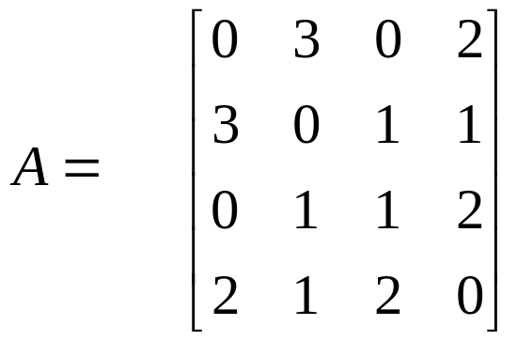
Example 5. (Pseudograph) (矩陣未必是0,1矩陣.)
a
b
c
d
a
b
a
b
c
d
d
c
Def. If A=[a_{ij}] is the adjacency matrix for the directed
graph, then
1 , if
v_{i}
v_{j}
(故矩陣未必對稱)
a_{ij} =
0 , otherwise
Exercise : 7, 14, 17, 23
Ch9-<number>

Slide 36
※Isomorphism of Graphs
u₁
u₂
v₁
v₂
G is isomorphic to H
u₃
u₄
v₃
v₄
G
H
Def 1.
The simple graphs G₁=(V₁,E₁) and G₂=(V₂,E₂) are isomorphic if there is an one-to-one and onto function f from V₁ to V₂ with the property that a~b in G₁ iff f(a)~f(b) in G₂, ∀a,b∈V₁
f is called an isomorphism.
Ch9-<number>

Slide 37
Example 8. Show that G and H are isomorphic.
u₁
u₂
v₁
v₂
u₃
u₄
v₃
v₄
G
H
Sol.
The function f with f(u₁) = v₁, f(u₂) = v₄, f(u₃) = v₃, and f(u₄) = v₂ is a one-to-one correspondence between V(G) and V(H).
※Isomorphism graphs 必有 : (1) 相同的點數
(2) 相同的邊數 (3) 相同的degree分佈。
Ch9-<number>

Slide 38
※給定二圖，判斷它們是否isomorphic的問題一般來說不易解，而且答案常是否定的。
Example 9. Show that G and H are not isomorphic.
G
H
Sol :
G 有 degree = 1 的點，H 沒有
Ch9-<number>

Slide 39
Example 10.
Determine whether G and H are isomorphic.
a
b
s
t
e
w
x
f
g
h
z
y
d
c
v
u
G
H
Sol : ∵ G 中 degree 為 3 的點有d, h, f, b
它們不能接成 4-cycle
但 H 中 degree 為3的點s, w, z, v 可接成 4-cycle
∴ 不是 isomorphic.
另法 : G 中 deg = 3的點，旁邊都只連了另一個 deg = 3 的點
但 H 中 deg = 3 的點旁邊都連了 2 個 deg = 3 的點
Ch9-<number>

Slide 40
Example 11. Determine whether the graphs G and H are isomorphic.
G
v₁
H
u₁
u₂
v₃
u₅
v₂
u₆
v₆
v₅
u₄
u₃
v₄
Sol:
f(u₁)=v₆, f(u₂)=v₃, f(u₃)=v₄, f(u₄)=v₅, f(u₅)=v₁, f(u₆)=v₂
⇒Yes
Exercise : 37, 39, 40
Ch9-<number>

Slide 41
Ex44. Determine whether the graphs G and H are isomorphic.
G
H
u₁
v₁
u₂
v₂
u₈
v₈
u₃
v₃
u₇
v₇
u₆
v₆
v₄
u₄
u₅
v₅
此二圖都是vertex-transitive，每個點的角色是一樣的，故考慮u₁及v₁即可
v₁的5 個neighbor可以連接成5-cycle，但u₁的不行，故不是isomorphic
Ch9-<number>

Slide 42
§10.4: Connectivity
Def. 1,2 :
In an undirected graph, a path of length n from u to v is a sequence of n+1 adjacent vertices going from vertex u to vertex v.
(e.g., P: u=x₀, x₁, x₂, …, x_{n}=v.) ( P has n edges.)
Def: (與書上的不太一致)
path中的點及邊不可重複
trail: 允許點重複的路徑 (邊不可重複)
walk: 允許點及邊重複的路徑
Example
v
w
path: u, v, y
trail: u, v, w, y, v, x, y
walk: u, v, w, v, x, v, y
u
x
y
Ch9-<number>

Slide 43
Def:
cycle: path with u=v
circuit: trail with u=v
closed walk: walk with u=v
Example
G
v
w
cycle: u, v, y, x, u
trail: u, v, w, y, v, x, u
walk: u, v, w, v, x, v, y, x, u
u
x
y
Exercise : 17
Ch9-<number>

Slide 44
Paths in Directed Graphs
The same as in undirected graphs, but the path must go in the direction of the arrows.
Connectedness in Undirected Graphs
Def. 3:
  An undirected graph is connected (連通) if there is a path between every pair of distinct vertices in the graph.
Def:
  Connected component: maximal connected subgraph. (一個不連通的圖會有好幾個component)
Ch9-<number>

Slide 45
Example 6 What are the connected components of the graph H?
b
f
d
e
a
c
h
g
H
Ch9-<number>

Slide 46
Def:
A cut vertex separates one connected component into several components if it is removed.
A cut edge separates one connected component into two components if it is removed.
Example 8. Find the cut vertices and cut edges in the
graph G.
Sol:
a
d
f
g
cut vertices: b, c, e
G
cut edges:
{a, b}, {c, e}
b
c
e
h
Exercise : 29,31, 32
Ch9-<number>

Slide 47
Connectedness in Directed Graphs
Def. 4: A directed graph is strongly connected if there is a path from a to b for any two vertices a, b.
A directed graph is weakly connected if there is a path between every two vertices in the underlying undirected graphs.
Example 9 Are the directed graphs G and H strongly
connected or weakly connected?
a
b
a
b
G
H
c
c
e
d
e
d
Ch9-<number>
strongly connected
weakly connected

Slide 48
Paths and Isomorphism
Note that connectedness, and the existence of a circuit or simple circuit of length k are graph invariants with respect to isomorphism.
Example 12. Determine whether the graphs G and
H are isomorphic.
u₁
v₁
v₂
v₆
u₂
u₆
v₃
v₅
u₃
u₅
H
v₄
u₄
G
Sol: No, 因G沒有三角形，H有
Ch9-<number>

Slide 49
Example 13. Determine whether the graphs G and
H are isomorphic.
u₂
v₁
G
H
u₁
u₃
v₅
v₂
u₅
u₄
v₄
Sol.
v₃
Both G and H have 5 vertices, 6 edges, two vertices of deg 3, three vertices of deg 2, a 3-cycle, a 4-cycle, and a 5-cycle. ⇒ G and H may be isomorphic.
The function f with f(u₁) = v₁, f(u₂) = v₄, f(u₃) = v₃,
f(u₄) = v₂ and f(u₅) = v₅ is a one-to-one correspondence between V(G) and V(H). ⇒ G and H are isomorphic.
Exercise : 19, 20
Ch9-<number>

Slide 50
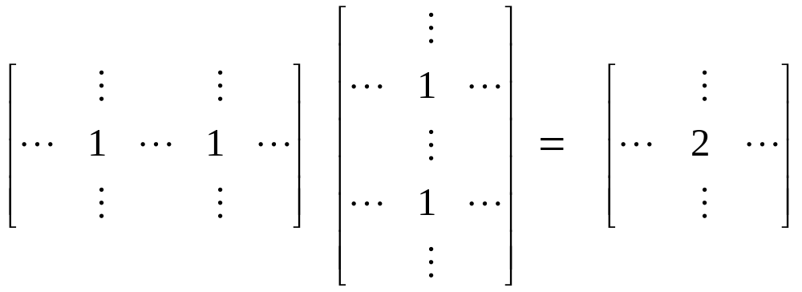
Counting Paths between Vertices
Theorem 2:
Let G be a graph with adjacency matrix A with respect to the ordering v₁, v₂, …, v_{n}. The number of walks of length r from v_{i} to v_{j} is equal to (A^{r})_{i,j}.
Proof (僅簡單舉例說明)
A
A
j
A²
a
b
j
a
i
i
b
a
i
j
Ch9-<number>
b

Slide 51
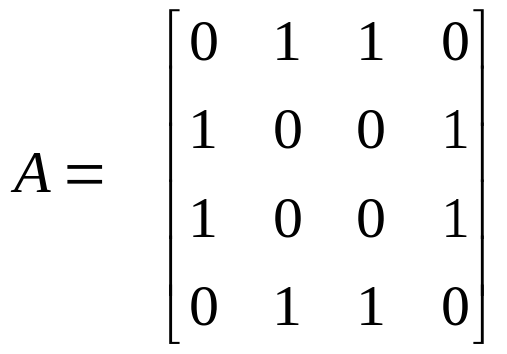
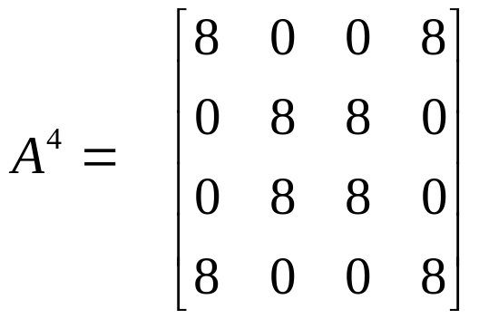
Example 14. How many walks of length 4 are
there from a to d in the graph G?
a
b
Sol.
The adjacency matrix of G
(ordering as a, b, c, d) is
G
d
c
a
b
c
d
a
b
⇒
⇒ 8
c
d
Q: 哪8條？
a-b-a-b-d, a-b-a-c-d, a-c-a-b-d, a-c-a-c-d,
a-b-d-b-d, a-b-d-c-d, a-c-d-b-d, a-c-d-c-d
Exercise : 17
Ch9-<number>

Slide 52
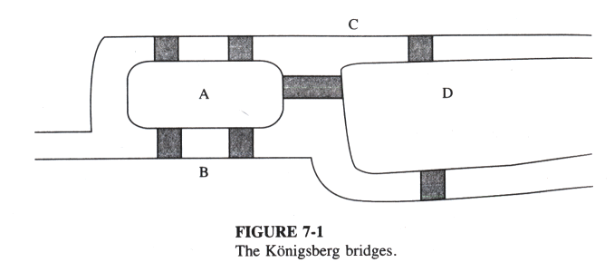
Graph Theory 的起源
§10.5: Euler & Hamilton Paths
1736, Euler solved the Königsberg Bridge Problem (七橋問題)
Q: 是否存在一
種走法，可以走
過每座橋一次，
並回到起點？
Ch9-<number>

Slide 53
Königsberg Bridge Problem
C
⇒
A
D
B
Q: 是否存在一種走法，可以走過每條邊一次，並回到起點？
Ans: 因為每次經過一個點，都需要從一條邊進入該點，再用另一條邊離開，所以經過每個點一次要使用掉一對邊。
⇒ 每個點上連接的邊數必須是偶數才行
⇒ 此種走法不存在
Ch9-<number>

Slide 54
Def 1:
An Euler circuit in a graph G is a simple circuit containing every edge of G.
An Euler path in G is a simple path containing every edge of G.
Thm. 1:
A connected multigraph with at least two vertices has an Euler circuit if and only if each of its vertices has even degree.
Thm. 2:
A connected multigraph has an Euler path (but not an Euler circuit) if and only if it has exactly 2 vertices of odd degree.
Ch9-<number>

Slide 55
Example 1. Which of the following graphs have
an Euler circuit or an Euler path?
a
a
b
G₃
a
b
b
G₁
e
G₂
e
c
d
c
c
d
e
d
Euler circuit
none
Euler path
Exercise : 3, 5, 21, 26, 28
Ch9-<number>

Slide 56
Algorithm 1 (Constructing Euler Circuits.)
Procedure Euler(G: connected multigraph with all vertices of even degree)
circuit := a circuit in G beginning at an arbitrary chosen vertex with edges successively added to form a path that returns to this vertex
H := G with the edges of this circuit removed
while H has edges
begin
subcircuit := a circuit in H beginning at a vertex in H that
also is an endpoint of an edge of circuit
H := H with edges of subcircuit and all isolated vertices
removed
circuit := circuit with subcircuit inserted at appropriate
vertex
end {circuit is an Euler circuit}
Ch9-<number>

Slide 57
Example
v₁
v₂
Step 1: find the 1st circuit
C: v₁, v₂, v₃, v₄, v₅, v₁
v₅
v₃
Step 2: H = G − C ≠ ∅,
find subcircuit
v₆
SC: v₃, v₅, v₆, v₃
v₄
Step 3:
C = C ∪ SC,
H= G − C =∅, stop
C: v₁, v₂, v₃, v₅, v₆, v₃, v₄, v₅, v₁
Exercise : 7
SC embedded
Ch9-<number>

Slide 58
Hamilton Paths and Circuits
Def. 2: A Hamilton path is a path that traverses each vertex in a graph G exactly once.
A Hamilton circuit is a circuit that traverses each vertex in G exactly once.
Example 1. Which of the following graphs have
a Hamilton circuit or a Hamilton path?
a
b
g
a
b
a
b
G₁
G₂
e
c
d
c
d
c
e
f
d
G₃
Exercise : 42, 43
Hamilton circuit: G₁
Hamilton path: G₁,G₂
Ch9-<number>

Slide 59
Thm. 3 (Dirac’s Thm.):
If (but not only if) G is a simple graph with n≥3 vertices such that the degree of every vertex in G is at least n/2, then G has a Hamilton circuit.
Example
b
a
each vertex has deg ≥ n/2 =3.5
⇒Hamilton circuit exists
如： a, c, e, g, b, d, f, a
g
c
f
d
e
Ch9-<number>

Slide 60
Thm. 4 (Ore’s Thm.):
If G is a simple graph with n≥3 vertices such that deg(u)+deg(v) ≥ n for every pair of nonadjacent vertices u and v, then G has a Hamilton circuit.
Example
b
a
each nonadjacent vertex pair
has deg sum ≥ n = 7
⇒Hamilton circuit exists
如： a, d, f, e, c, b, g, a
g
c
f
d
e
Ch9-<number>

Slide 61
§10.6: Shortest-Path Problems
Def:
1. Graphs that have a number assigned
to each edge are called weighted graphs.
2. The length of a path in a weighted graph is
the sum of the weights of the edges of this
path.
Shortest path Problem:
Determining the path of least sum of the weights between two vertices in a weighted graph.
Ch9-<number>

Slide 62
Example 1. What is the length of a shortest path between a and z in the weighted graph G?
b
3
c
Sol.
L=0
a
(1)
(2)
2
a
L=2
4
2
z
L=4
d
a
3
b
1
b
2
(3)
4
G
(4)
4
d
3
e
a
a
2
L=5
2
d
3
d
e
每個step都從還未處理的點
找離a最近的，此時a至該點的
shortest path就找到了。
b
(5)
4
L=6
a
z
length=6
2
1
d
3
e
Ch9-<number>

Slide 63
Dijkstra’s Algorithm
(find the length of a shortest path from a to z)
Procedure Dijkstra(G: weighted connected simple graph, with all weights positive)
{G has vertices a = v₀, v₁, …, v_{n} = z and weights w(v_{i}, v_{j})
where w(v_{i}, v_{j}) = ∞ if {v_{i}, v_{j}} is not an edge in G}
for i := 1 to n
L(v_{i}) := ∞
L(a) := 0
S := ∅
while z ∉ S
begin
u := a vertex not in S with L(u) minimal
S := S ∪ {u}
for all vertices v not in S
if L(u) + w(u, v) < L(v) then L(v) := L(u) + w(u, v)
end {L(z) = length of a shortest path from a to z}
This algorithm can be extended
to construct a shortest path.
此處加一個變數
紀錄 v 的前一點是 u
previous(v) := u
演算法最後再從 z 往前trace
Ch9-<number>

Slide 64
Example 2. Use Dijkstra’s algorithm to find the length of a shortest path between a and z in the weighted graph.
4(a)
∞
∞
∞
b
5
d
Sol.
b
5
d
b
5
d
4
6
4
6
4
6
8
0
8
⇒
0
8
a
1
z
a
1
z
a
1
z
2
2
∞
2
∞
2
3
2
3
2
3
c
10
e
c
10
e
c
10
e
∞
∞
∞
2(a)
3(c)
3(c)
3(c)
8(b)
10(c)
8(b)
b
5
d
b
5
d
b
5
d
⇒
⇒
6
⇒
4
6
4
6
4
0
8
0
8
0
8
14
(d)
a
z
a
z
a
1
z
1
2
1
2
2
∞
∞
2
3
2
3
2
3
e
e
c
10
e
c
10
c
10
2(a)
12(c)
2(a)
12(c)
2(a)
10(d)
Ch9-<number>

Slide 65
(前頁最後一個圖)
3(c)
8(b)
3(c)
8(b)
b
5
d
b
5
d
4
6
4
6
0
8
14(d)
⇒
0
8
13(e)
a
1
z
a
1
z
2
2
2
3
2
3
c
10
e
c
10
e
2(a)
10(d)
2(a)
10(d)
3(c)
8(b)
b
5
d
⇒
4
6
⇒ path: a, c, b, d, e, z
length: 13
0
8
13(e)
a
1
z
2
2
3
c
10
e
2(a)
10(d)
Exercise : 3
Ch9-<number>

Slide 66
Thm. 1
Dijkstra’s algorithm finds the length of a shortest path between two vertices in a connected simple undirected weighted graph.
Thm. 2
Dijkstra’s algorithm uses O(n²) operations (additions and comparisons) to find the length of a shortest path between two vertices in a connected simple undirected weighted graph with n vertices.
Ch9-<number>

Slide 67
Floyd’s Algorithm (find the distance d(a, b) ∀a, b)
Procedure Floyd(G: weighted simple graph)
{G has vertices v₁, …, v_{n} and weights w(v_{i}, v_{j}) with
w(v_{i}, v_{j}) = ∞ if {v_{i}, v_{j}} is not an edge}
for i := 1 to n
for j := 1 to n
d(v_{i}, v_{j}) := w(v_{i}, v_{j})
for i := 1 to n
for j := 1 to n
for k := 1 to n
if d(v_{j}, v_{i}) + d(v_{i}, v_{k}) < d(v_{j}, v_{k})
then d(v_{j}, v_{k}) := d(v_{j}, v_{i}) + d(v_{i}, v_{k})
{d(v_{i}, v_{j}) is the length of a shortest path between v_{i} and v_{j}}
v_{i}
v_{j}
v_{k}
對每個v_{i}，檢查任何一對點
v_{i}, v_{k} 目前的距離會不會因為改走 v_{i} 而變小。
This algorithm cannot be used to
construct shortest paths.
Exercise : 21
Ch9-<number>

Slide 68
The Traveling Salesman Problem: (簡介)
A traveling salesman wants to visit each of n cities exactly once and return to his starting point. In which order should he visit these cities to travel the minimum total distance?
Example (starting point D)
S
113
D→T→K→G→S →D: 458
G
137
147
142
98
167
D→T→S→G→K→D: 504
56
D
135
D→T→S→K→G→D: 540
58
K
133
T
…
相當於在complete weighted graph 上找 minimum weight Hamiltonian circuit.
不存在polynomial time alg. 效率好的 algorithm 只能找近似解
Ch9-<number>

Slide 69
§10.7: Planar Graphs
Def 1.
A graph is called planar if it can be drawn in the plane without any edge crossing. Such a drawing is called a planar representation of the graph.
Example 1: Is K₄ planar?
∴ K₄ is planar
K₄
K₄ drawn with
no crossings
Ch9-<number>

Slide 70
Example 2: Is Q₃ planar?
∴ Q₃ is planar
Q₃
Q₃ drawn with no crossings
Example 3: Show that K_{3,3} is nonplanar.
a
b
c
Sol.
a
R₁
e
a
e
R₂
c
f
d
e
f
d
b
d
b
任何畫法中，aebd都是cycle，
並將平面切成兩個region
不管 c 在哪個region，都無法
再將 f 放入而使邊不交錯
Ch9-<number>
Exercise: 3, 4

Slide 71
Euler’s Formula
A planar representation of a graph splits the plane into regions, including an unbounded region.
Example : How many regions are there in the following graph?
R₄
R₆
R₂
R₃
Sol. 6
R₁
R₅
Thm 1 (Euler’s Formula)
Let G be a connected planar simple graph with e edges and v vertices. Let r be the number of regions in a planar representation of G. Then r = e−v +2.
Ch9-<number>

Slide 72
Example 4: Suppose that a connected planar graph has 20 vertices, each of degree 3. Into how many regions does a representation of this planar graph split the plane?
Sol.
v = 20, 2e = 3×20 = 60, e = 30
r = e−v+2 = 30−20+2 = 12
Exercise: 13
Corollary 1
If G is a connected planar simple graph with e edges and v vertices, where v ≥ 3, then e ≤ 3v − 6.
Example 5: Show that K₅ is nonplanar.
Sol.
v= 5, e = 10, but 3v − 6 = 9.
Ch9-<number>

Slide 73
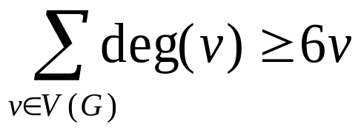
Corollary 2
If G is a connected planar simple graph, then G has a vertex of degree ≤ 5.
pf:
Let G be a planar graph of v vertices and e edges.
If deg(v) ≥ 6 for every v∈V(G)
⇒
⇒
2e ≥ 6v →← (e ≤ 3v − 6)
Ch9-<number>

Slide 74
Corollary 3
If a connected planar simple graph has e edges and v vertices with v ≥ 3 and no circuits of length three, then e ≤ 2v − 4.
Example 6: Show that K_{3,3} is nonplanar by Cor. 3.
Sol.
Because K_{3,3} has no circuits of length three, and v = 6, e = 9, but e = 9 > 2v − 4.
a
b
c
d
e
f
Ch9-<number>

Slide 75
Kuratowski’s Theorem
If a graph is planar, so will be any graph obtained by removing an edge {u, v} and adding a new vertex w together with edges {u, w} and {v, w}.
u
w
v
Such an operation is called an elementary subdivision.
Two graphs G₁ = (V₁, E₁), G₂=(V₂, E₂) are called homeomorphic if they can be obtained from the same graph by a sequence of elementary subdivisons.
Ch9-<number>

Slide 76
Example 7: Show that the graphs G₁, G₂, and G₃ are all homeomorphic.
a
b
a
b
a
b
h
i
k
f
j
g
g
c
d
e
c
d
e
c
d
e
Sol: all three can be obtained from G₁
Exercise: 21
Thm 2. (Kuratowski Theorem)
A graph is nonplanar if and only if it contains
a subgraph homeomorphic to K_{3,3} or K₅.
Ch9-<number>

Slide 77
Example 9: Show that the Petersen graph is not planar.
Sol:
7
1
6
5
8
2
3
4
9
It is homeomorphic to K_{3,3}.
1
2
3
8
9
7
Ch9-<number>
4
5
6

Slide 78
§10.8: Graph Coloring
Def. 1:
A coloring of a simple graph is the assignment of a color to each vertex of the graph so that no two adjacent vertices are assigned the same color.
Example:
2
1
2
3
5
1
1
2
1
1
4
3
3
2
5-coloring
3-coloring
顏色數越少越好
Ch9-<number>

Slide 79
Def. 2:
The chromatic number of a graph is the least number of colors needed for a coloring of this graph. (denoted by χ(G))
Example 2: χ(K₅)=5
1
2
5
3
4
Note: χ(K_{n})=n
Ch9-<number>

Slide 80
Example: χ(K_{2,3}) = 2.
1
1
2
2
2
Note: χ(K_{m,n}) = 2
Note: If G is a bipartite graph, χ(G) = 2.
Ch9-<number>

Slide 81
Example 1: What are the chromatic numbers of the graphs G and H?
2
3
1
a
1
1
g
3
2
G
H
Sol: G has a 3-cycle
⇒ χ(G)≥3
Sol: any 3-coloring for
H−{(a,g)} gives the
same color to a and g
⇒ χ(H)>3
G has a 3-coloring
⇒ χ(G)≤3
⇒ χ(G)=3
4-coloring exists ⇒ χ(H)=4
Ch9-<number>

Slide 82
Example 4: χ(C_{n}) = 2 if n is even,
3 if n is odd.
{
1
2
C_{n} is bipartite
when n is even.
3
1
2
Thm 1. (The Four Color Theorem)
The chromatic number of a planar graph is no
greater than four.
Corollary
Any graph with chromatic number >4 is nonplanar.
Exercise: 8, 9, 15
Ch9-<number>

